Slide 1
Snack to Smoothie Swap
Live Lean Health
Notes:
Line spacing + Page numbers

Slide 2
Welcome My name is Chantal, I am a Board certified Holistic Health Coach, plant based Nutritional advisor, Functional movement teachers and Author. I am also the founder of @LiveLeanHealth and Eco Dharma Village in Portugal. I have been Vegan since 2013 and not a day goes by that my only regret is not to have gone plant based sooner. My health and mental clarity took a turn, for the better, the moment I cut animal products and built a closer relationship with nature. Not to mention that my love for animals started making sense too. In my practice, I focus on transforming women’s health through plants, which I believe are God’s medicine! I am so incredibly passionate about this journey and I cannot wait to take you along with me for a week of fun, enjoying some smoothies and getting you started on your path to health too. Learn how to works NEXT
Notes:
Line spacing + Page numbers

Slide 3
How it works Hey friend, once again, thank you for downloading this resource. I am so excited to have you onboard for, what I believe, will be an exciting and fun week ! The aim of this program is to inspire you to upgrade your health by incorporatig more fruit and vegetables in your day, in a simple and delcious way: via smoothies! These plant powered recipes are filling, healthy and YUMMY! This is how this works: You will swap any of your current snacks, for one of these smoothies! In doing so, you are not depriving yourself of anything, rather, adding in and naturally crowding out what could possibly be «not so healthy», for an alternative that will offer you vitality and joy! Trust me when I say: plants bring JOY! Are you ready? Let’s do this! YOU WILL LOVE IT!
Notes:
Line spacing + Page numbers

Slide 4
Equipment & Tips Smoothies are very easy to make. You need just one appliance: a blender. Investing in a good blender, like a Vitamix, has many advantages , but it is not necessary. If you are uisng a less powerful machine, then there are some tips to help you obtain the smoothiest texture for your drinks: 1. Always peel and cut your fruit before freezing (with the exception of apples or pears and clearly berries) 2. Chop the ingredients as finely as you can, so invest in a good knife. 3. Allow frozen ingredients to thaw a little before blending. Usually taking them out of the freezer 10 minutes before use is enough. 4. Swap plant based milks as per your likings. Choose more grain based milksor soy to limit your fat intake if necesary (always read the ingredients list) 5. Use what you have! If a recipe calls for an ingredient that you do not have or like, and you have others avaiable, feel free to get creative. Unless you add the likes of onions in your smoothies, there is little chance to go wrong ☺
Notes:
Line spacing + Page numbers

Slide 5
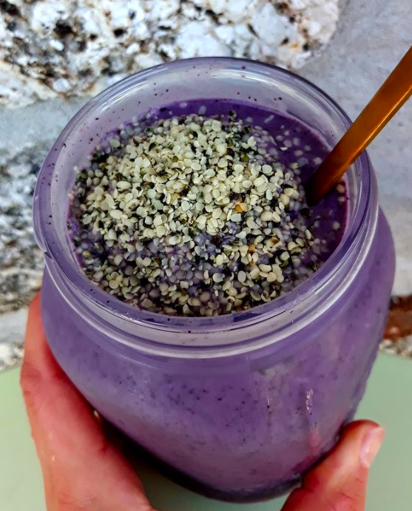
Merry Berry Smoothie
Ingredients
2 frozen bananas
1 frozen zucchini
100g (1/2 cup) of frozen blueberries
1 pitted date
½ tsp vanilla powder (optional)
250ml (8oz) plant based milk (I used hemp)
Optional: top with hemp seeds
Method
Place all the ingredients in the blender and blend till it is completely smooth and silky!
Enjoy

Slide 6
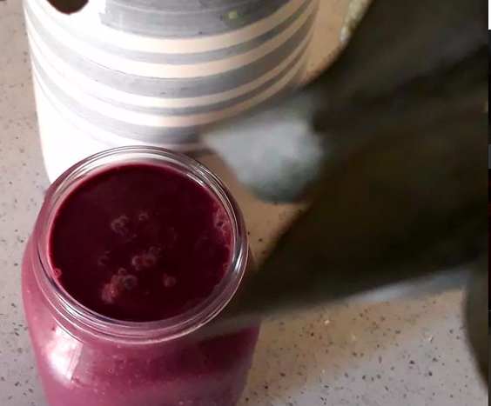
Black Forrest Smoothie
Ingredients
2 frozen bananas
100g (1/2 cup) of frozen mixed berries or cherries
2 large leaves of dino kale (remove stem)
2 pitted dates
1 tsbp raw cacao
½ tsp beetroot powder or ½ raw beet (optional)
1 tsp cinnamon
250ml (8oz) plant based milk (I used soy)
1 tsp cashew butter (optional)
Method
Place all the ingredients in the blender and blend till it is completely smooth and silky!
Enjoy
Tip: Remove the cashew butter to keep it low fat.

Slide 7
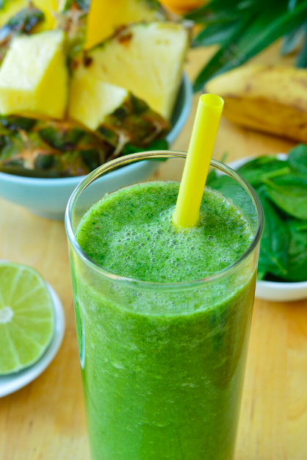
Greeña Colada
Ingredients
1 frozen zucchini
200g (1 cup) frozen pineapple (cubes) 2 cups watercress
2 pitted dates 250ml (8oz) coconut water
Method
Place all the ingredients in the blender and blend till it is completely smooth and silky!
Enjoy
Tip: Use coconut milk for a richer consistency

Slide 8
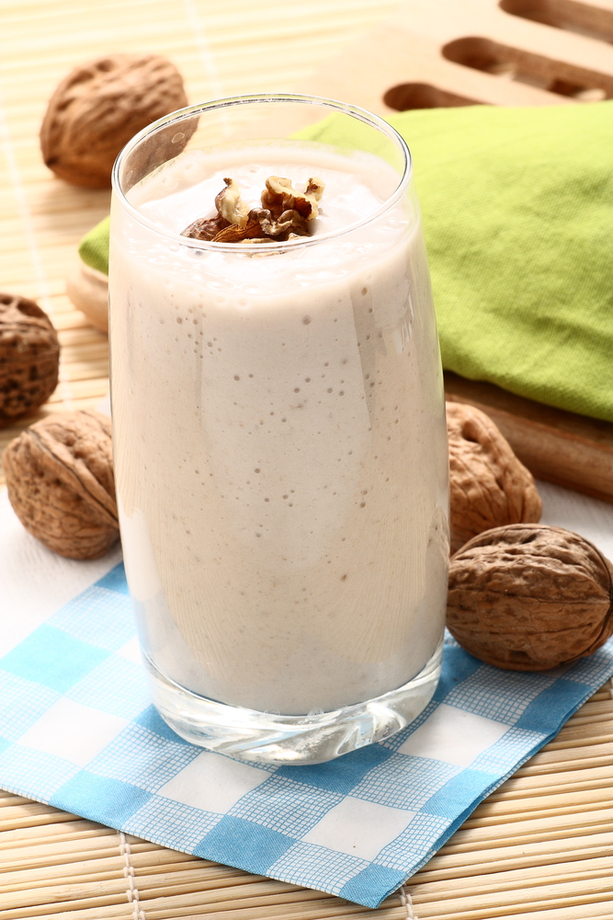
Brain Boost Smoothie
Ingredients
2 frozen bananas 2 cups raw walnuts
½ tsp cinnamon
1 tbsp raw cacao 250ml (8oz) plant milk of choice
Optional: 1 tsp Bramhi (Bacopa Monnieri)
Method
Place all the ingredients in the blender and blend till it is completely smooth and silky!
Enjoy
Tip: Brahmi is an Ayurvedic herb for brain health and memory boost. You can find this online and with Ayurvedic practitioners. However, please always consult your MD if on any medication before adding any type of superfood.

Slide 9
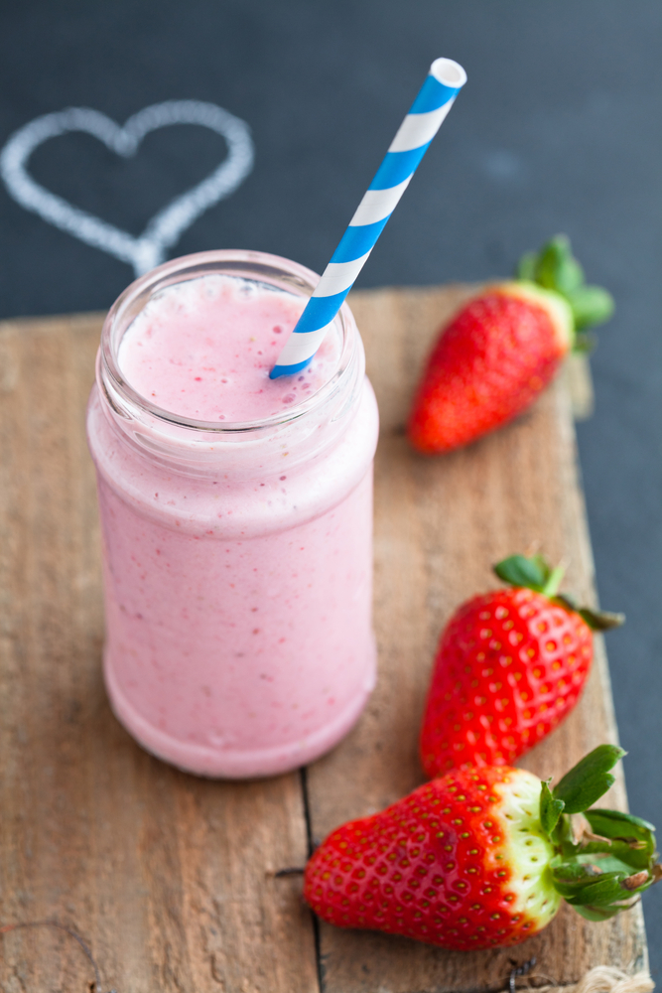
OM Smoothie
Ingredients
2 frozen bananas
100g (1/2 cup) frozen strawberries ½ Apple (I love pink ladies)
½ tsp cinnamon
1 tsp Ashwaghanda (optional) 250ml (8oz) plant milk of choice
Method
Place all the ingredients in the blender and blend till it is completely smooth and silky!
Enjoy
Tip: Ashwagandha is a powerful Ayurvedic herb with an array of health benefits, including hormones balancing. It is called an Adaptogen. You can find this online and with Ayurvedic practitioners. However, please always consult your MD if on any medication before adding any type of superfood.

Slide 10
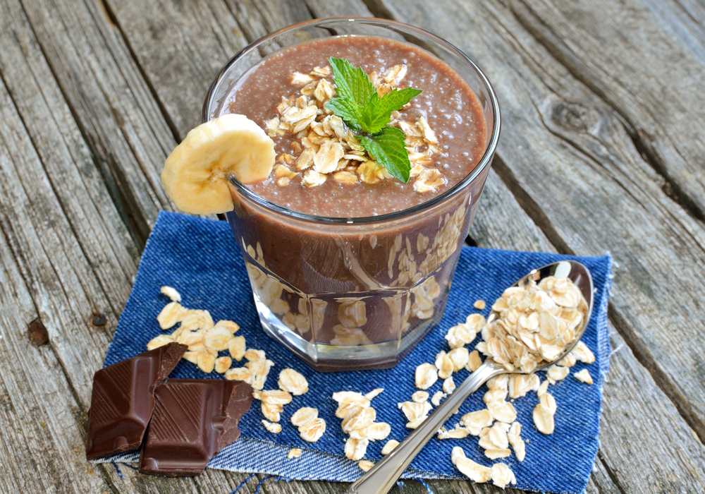
OH MY! Smoothie
Ingredients
2 frozen bananas
2 tbsp oats
1 tsp Maca powder (optional)
1 tbsp peanut butter
1 tbsp Raw cacao
½ Pear ½ tsp cinnamon 250ml (8oz) plant milk of choice (I use Oat)
Method
Place all the ingredients in the blender and blend till it is completely smooth and silky!
Enjoy
Tip: Maca is a wonderful adaptogen from Peru. It has many health benefits, including supporting adrenal functions and balancing hormones. You can find this online and at health stores. Please always consult your MD if on any medication before adding any type of superfood.

Slide 11
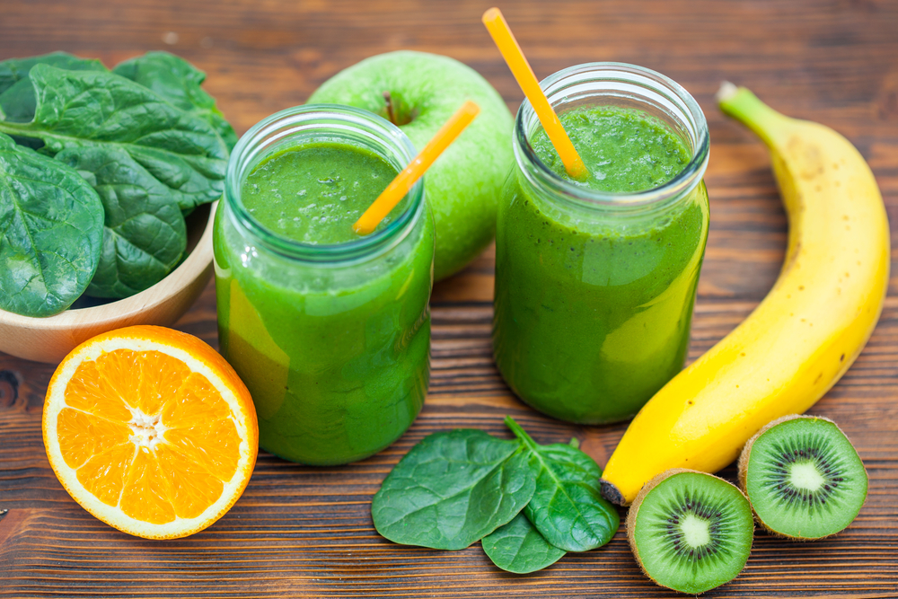
Green Machine
Ingredients
2 frozen bananas
100g (1/2 cup) frozen mix of pineapple, mango and papaya 1 green apple
1 Kiwi (peeled)
1 thump ginger (peeled)
1 slice of orange (peeled)
1 cup of spinach
½ tsp cinnamon 250ml (8oz) coconut water
Method
Place all the ingredients in the blender and blend till it is completely smooth and silky!
Enjoy

Slide 12
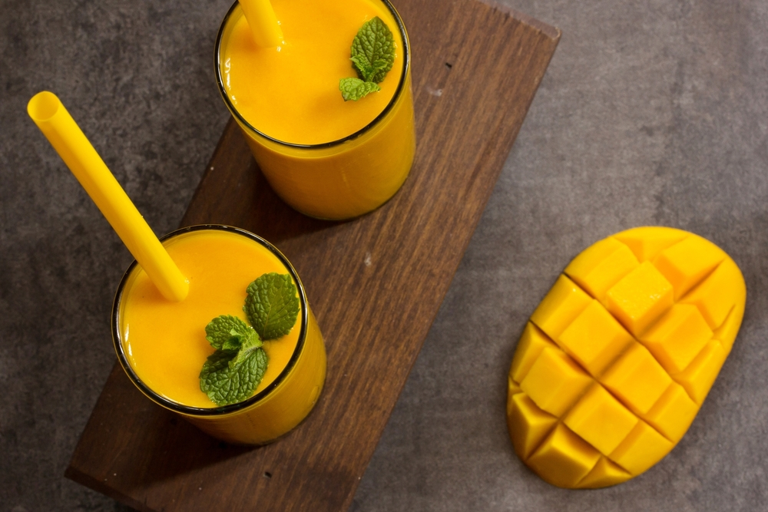
Mango Bango Smoothie
Ingredients
2 frozen bananas
1 frozen mango (cut in cubes) 1 green apple
½ tsp of grated ginger
½ lime’s juice
½ tsp cinnamon
A few leaves of fresh mint to taste 250ml (8oz) coconut water or coconut milk for more creaminess
Method
Place all the ingredients in the blender and blend till it is completely smooth and silky!
Enjoy

Slide 13
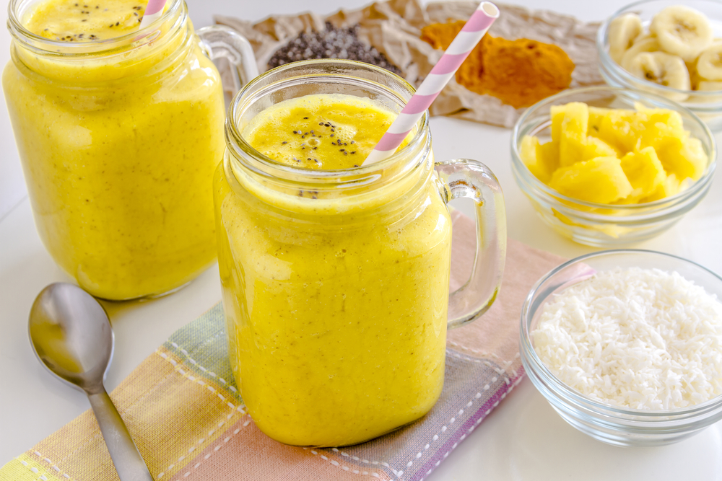
Anti-inflammatory Smoothie
Ingredients
2 frozen bananas
100g (1/2 cup) frozen pineapple 1 tsp turmeric powder
½ tsp cinnamon
¼ tsp black pepper 250ml (8oz) plant based milk of choice
Optional: top with desiccated coconut
Method
Place all the ingredients in the blender and blend till it is completely smooth and silky!
Enjoy

Slide 14
Thank You Thank you taking part in this loving week of Snacks to Smoothie Swap! I am excited to receiving feedback and of course, if you have any question, don’t hesitate to getting in touch. Love & Health @liveleanhealth Chantal@liveleanhealth.com
Notes:
Line spacing + Page numbers

